Slide 1
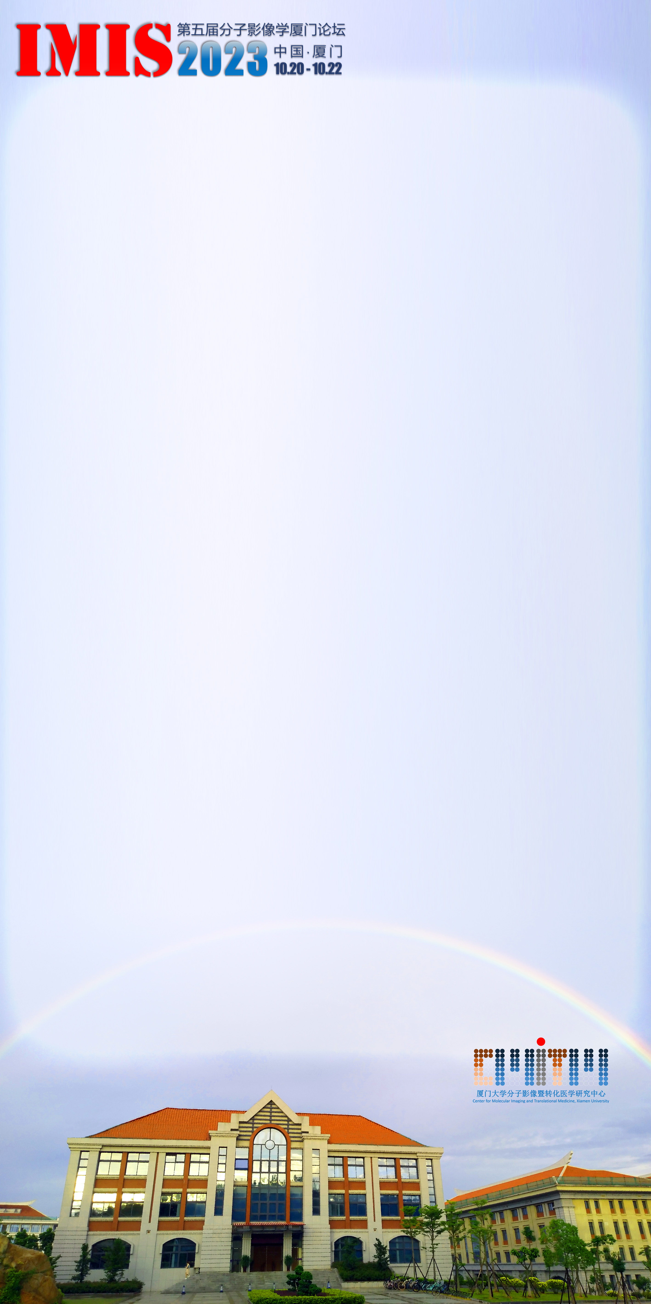
（制作壁报时，请删除本提示。）
提示：
请将壁报内容填入此区域。壁报尺寸为1m（宽）×2m（高），为保证展示效果，请提供高分辨率的图像（≥300dpi）。
( Please delete this text box while your poster preparation..)
Note:
Please fill your data in this area. The poster size is 1m (W) × 2 m (H), and images with high resolution (≥ 300 dpi) would be better for exhibition.

